Slide 1
MinION Loading
Rapid Response – Updated Jan 2026

Slide 2
How much concentration do I really need?
Final pool
  Need 100-150 fmol to load the flow cell
  = 11ul of 10-15nM
Individual samples:
  Ideally individual samples would also have 10-15nM
    (7-10ng/ul for 1000bp library)
    (13-20ng/ul for 2000bp library)
  Total mass (ng) per sample added to pool will depend on:
    library size
    # of samples in the pool

Slide 3
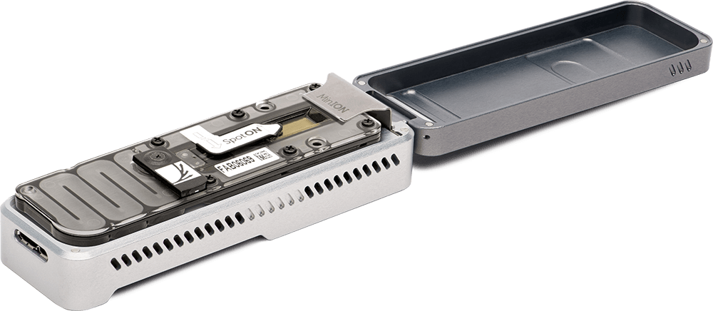
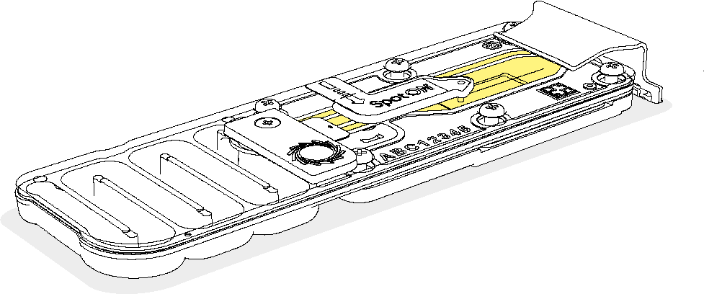
Before Loading...
MinION instrument
Thaw loading reagents
  ~30 min at room temperature
Take out SpotON flow cell from 4ºC
If it’s your first time loading, watch this video to see how it is done
Ensure that the MinION is connected to the computer and the software (MinKNOW) is up to date
Insert the flow-cell in the instrument
Perform a flow cell check and ensure that at least 800 pores are available* (ideally 1200-1800)
Flow cell
*ONT guarantees 800 active pores; you can sequence with fewer, but less data will be generated

Slide 4
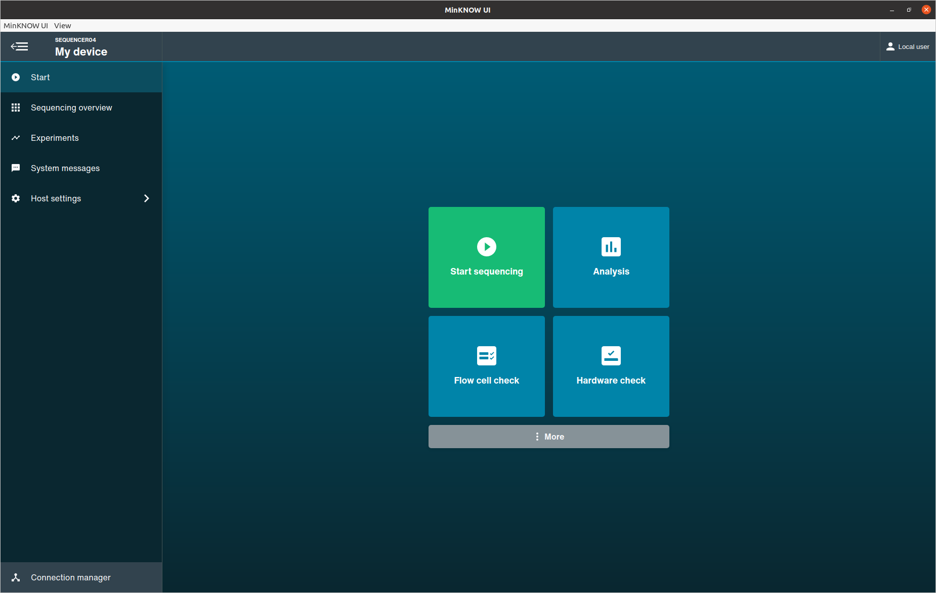
Perform a Flow cell check to identify the number of available pores for sequencing

Slide 5
Loading the flow cell
Follow the ONT protocol for “Priming and loading the MinION and GridION Flow Cell”
(link here)
If it is your first time loading, watch the “Priming and loading your flow cell” video (link here)
Notes:
Generally, library beads (LIB) are used for loading, and library solution (LIS) is not used
Use Bovine Serum Albumin (BSA) if you have the exact catalog number listed in the protocol (otherwise skip)

Slide 6
Starting a sequencing run

Slide 7
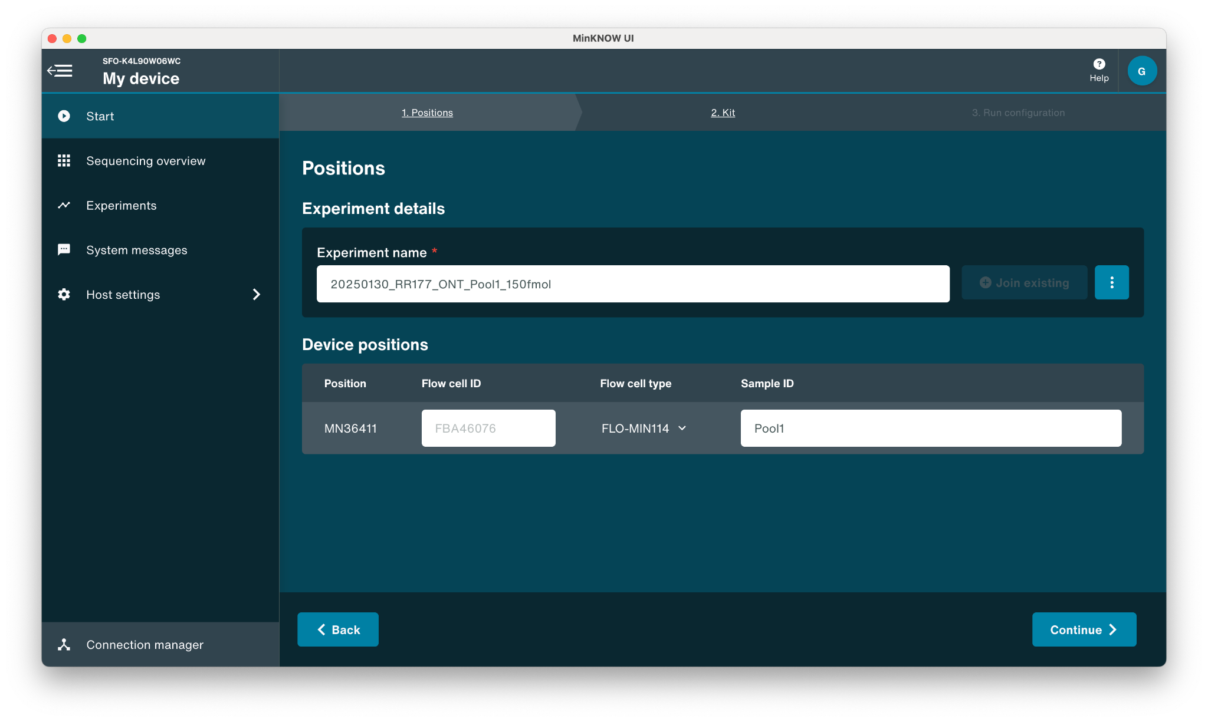
Starting a sequencing run

Slide 8
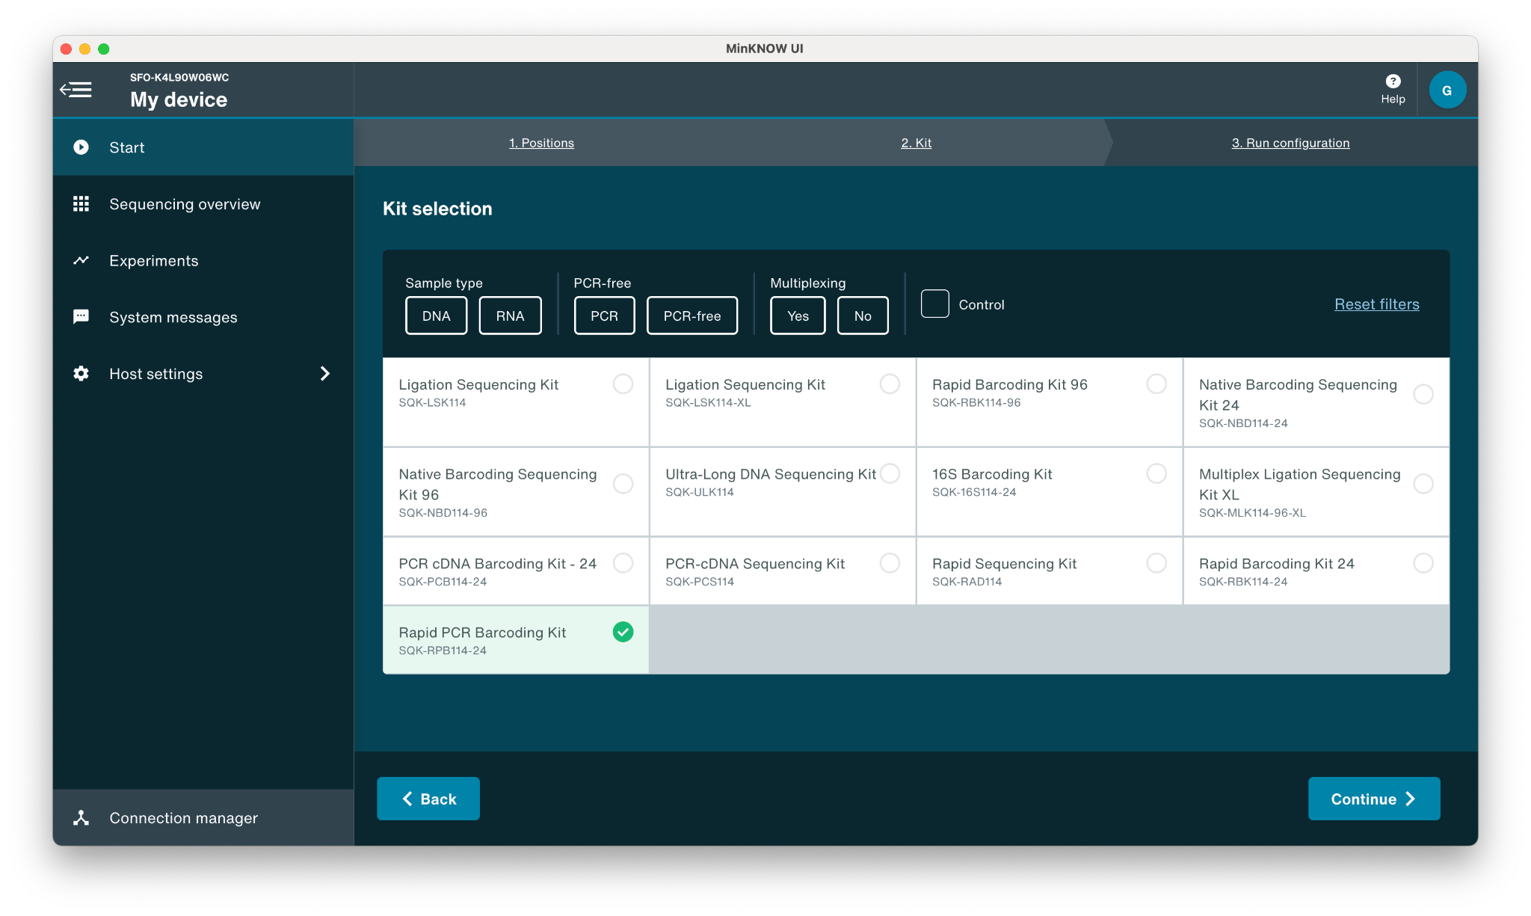
Select library prep kit used: SQK-RPB114-24 Rapid PCR Barcoding Kit
Select appropriate kit used for library prep

Slide 9
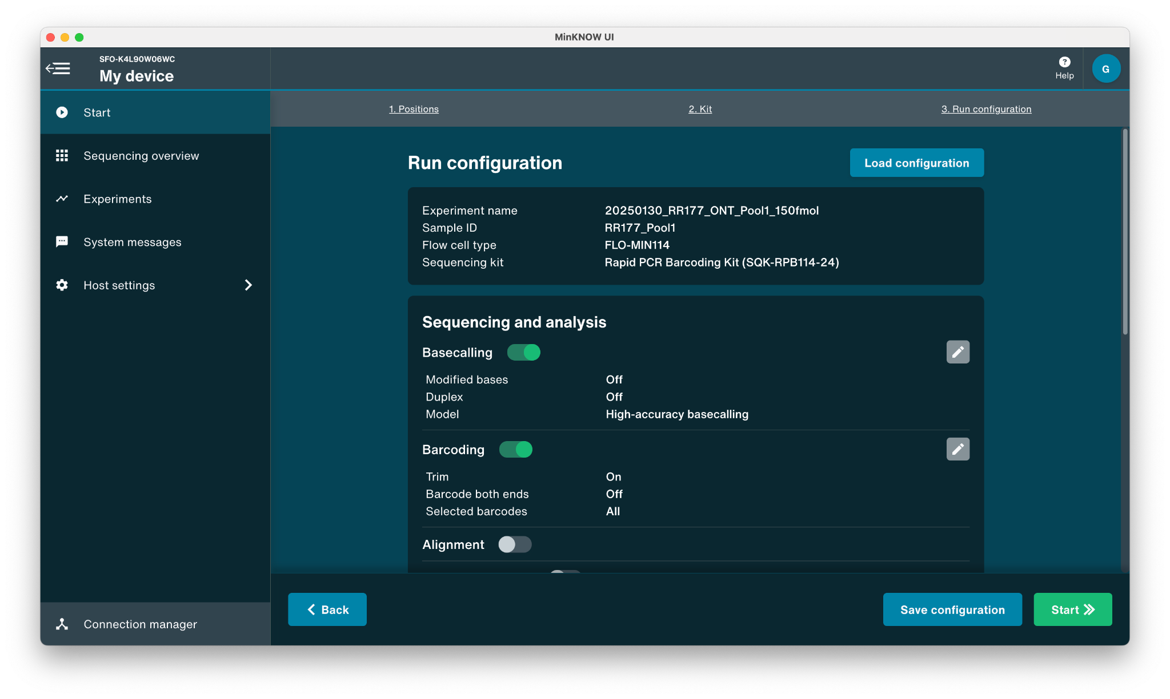
Select a basecaller
Select appropriate basecaller

Slide 10
Select a basecaller
High-accuracy or super-accurate basecalling is recommended
(the choice is a balance between accuracy and available computational power)
Select appropriate basecaller

Slide 11
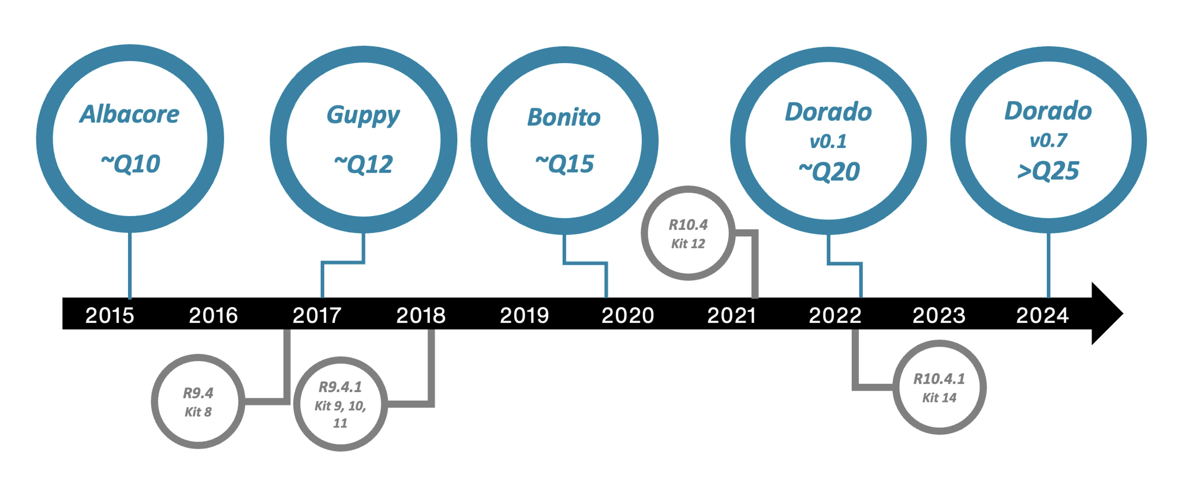
Intro to basecallers
What do they do?
Input raw ONT data (POD5)
Output basecalled data (FASTQ)
Basecaller options
Fast
High Accuracy (HAC)
Super Accuracy (SUP)
ONT Basecaller programs
ONT periodically releases new basecallers

Slide 12
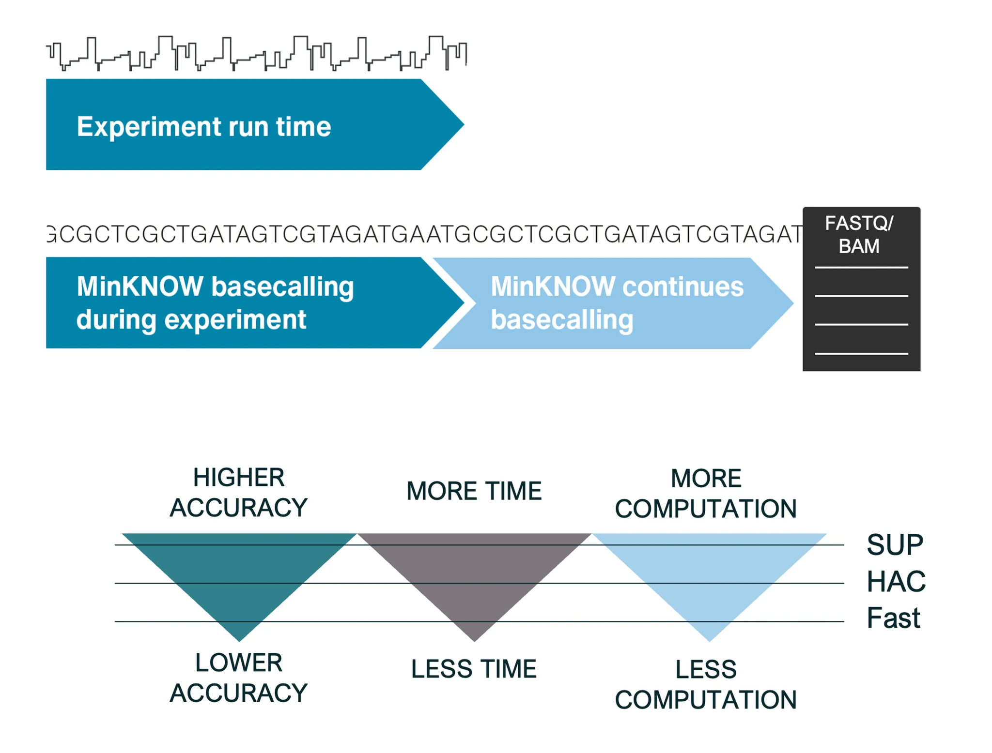
Basecallers differ in accuracy, computational power required, and time
Higher accuracy basecallers will require more computation and time
Fast basecallers can keep up with sequencing runs

Slide 13
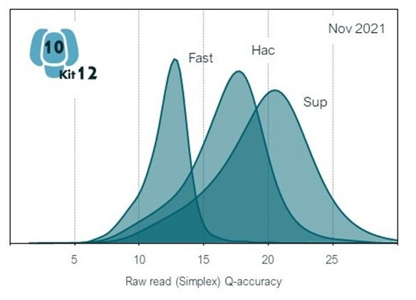
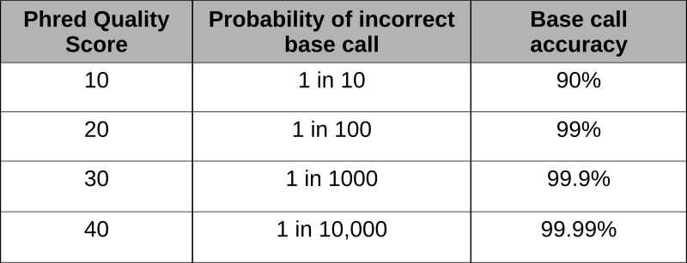
Comparison of Dorado basecalling models - accuracy
Basecalling accuracy is measured in Phred quality score (Q score)
A Phred quality score (Q score) is a measure of confidence of the basecall based on the estimated error rate.

Slide 14
The choice of basecaller is dependent on the computational resources available, time, and accuracy required.
Fast basecalling: fastest, least computationally intense. Compatible with real-time basecalling on all nanopore devices with compute. Recommended for quick, real-time insights on sequencing data when compute resources are limited.
High accuracy basecalling (HAC): highly accurate, intermediate speed and computational requirement. Recommended for high-throughput projects focusing on variant analysis.
Super accuracy basecalling (SUP): the most accurate and computationally intense. Recommended for de novo assembly projects and low-frequency variant analysis (e.g. somatic variation and single-cell applications).
https://nanoporetech.com/platform/accuracy

Slide 15
So which basecaller should I use?
Real time during the run: HAC if possible, but if computation is limited, choose fast
Preliminary data analysis: fast is okay
Final data analysis: HAC or SUP* is recommended
*SUP may be too computationally intensive

Slide 16
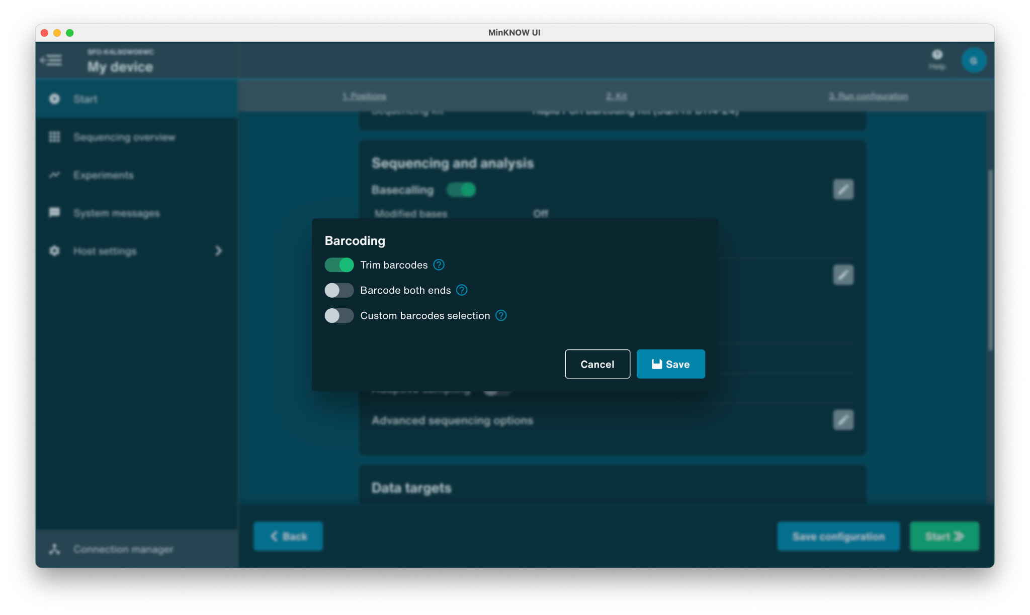
Trim barcodes: ON
Trim barcodes: ON

Slide 17
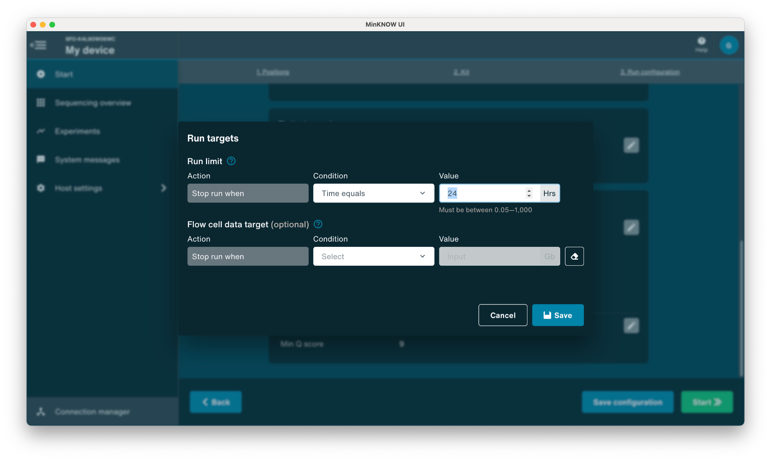
Set run duration
Set run duration
Maximum run time is 72 hrs
(data will be generated in near real-time regardless)
Pores get exhausted over time, so increasing run time may have diminishing returns

Slide 18
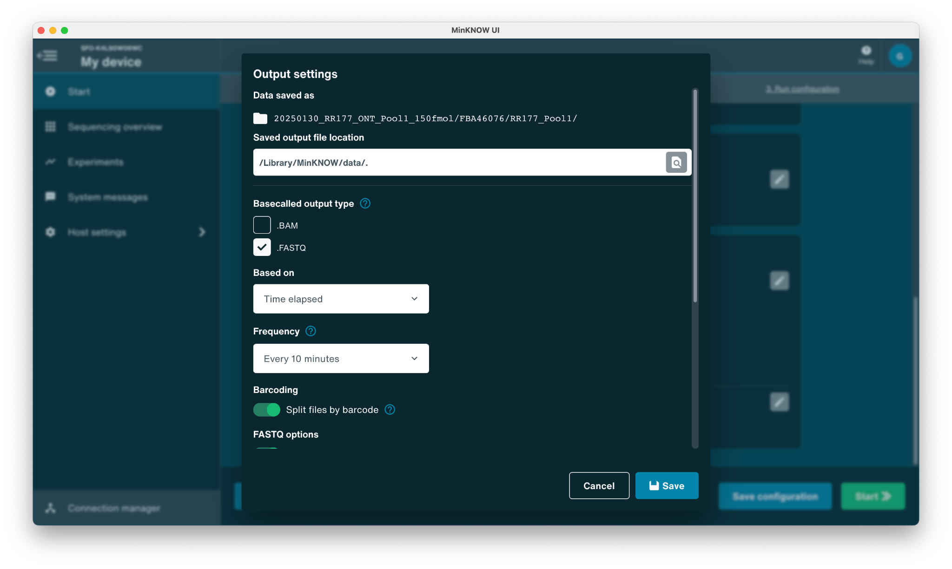
Save output files every 10 minutes
In case of run disruption

Slide 19
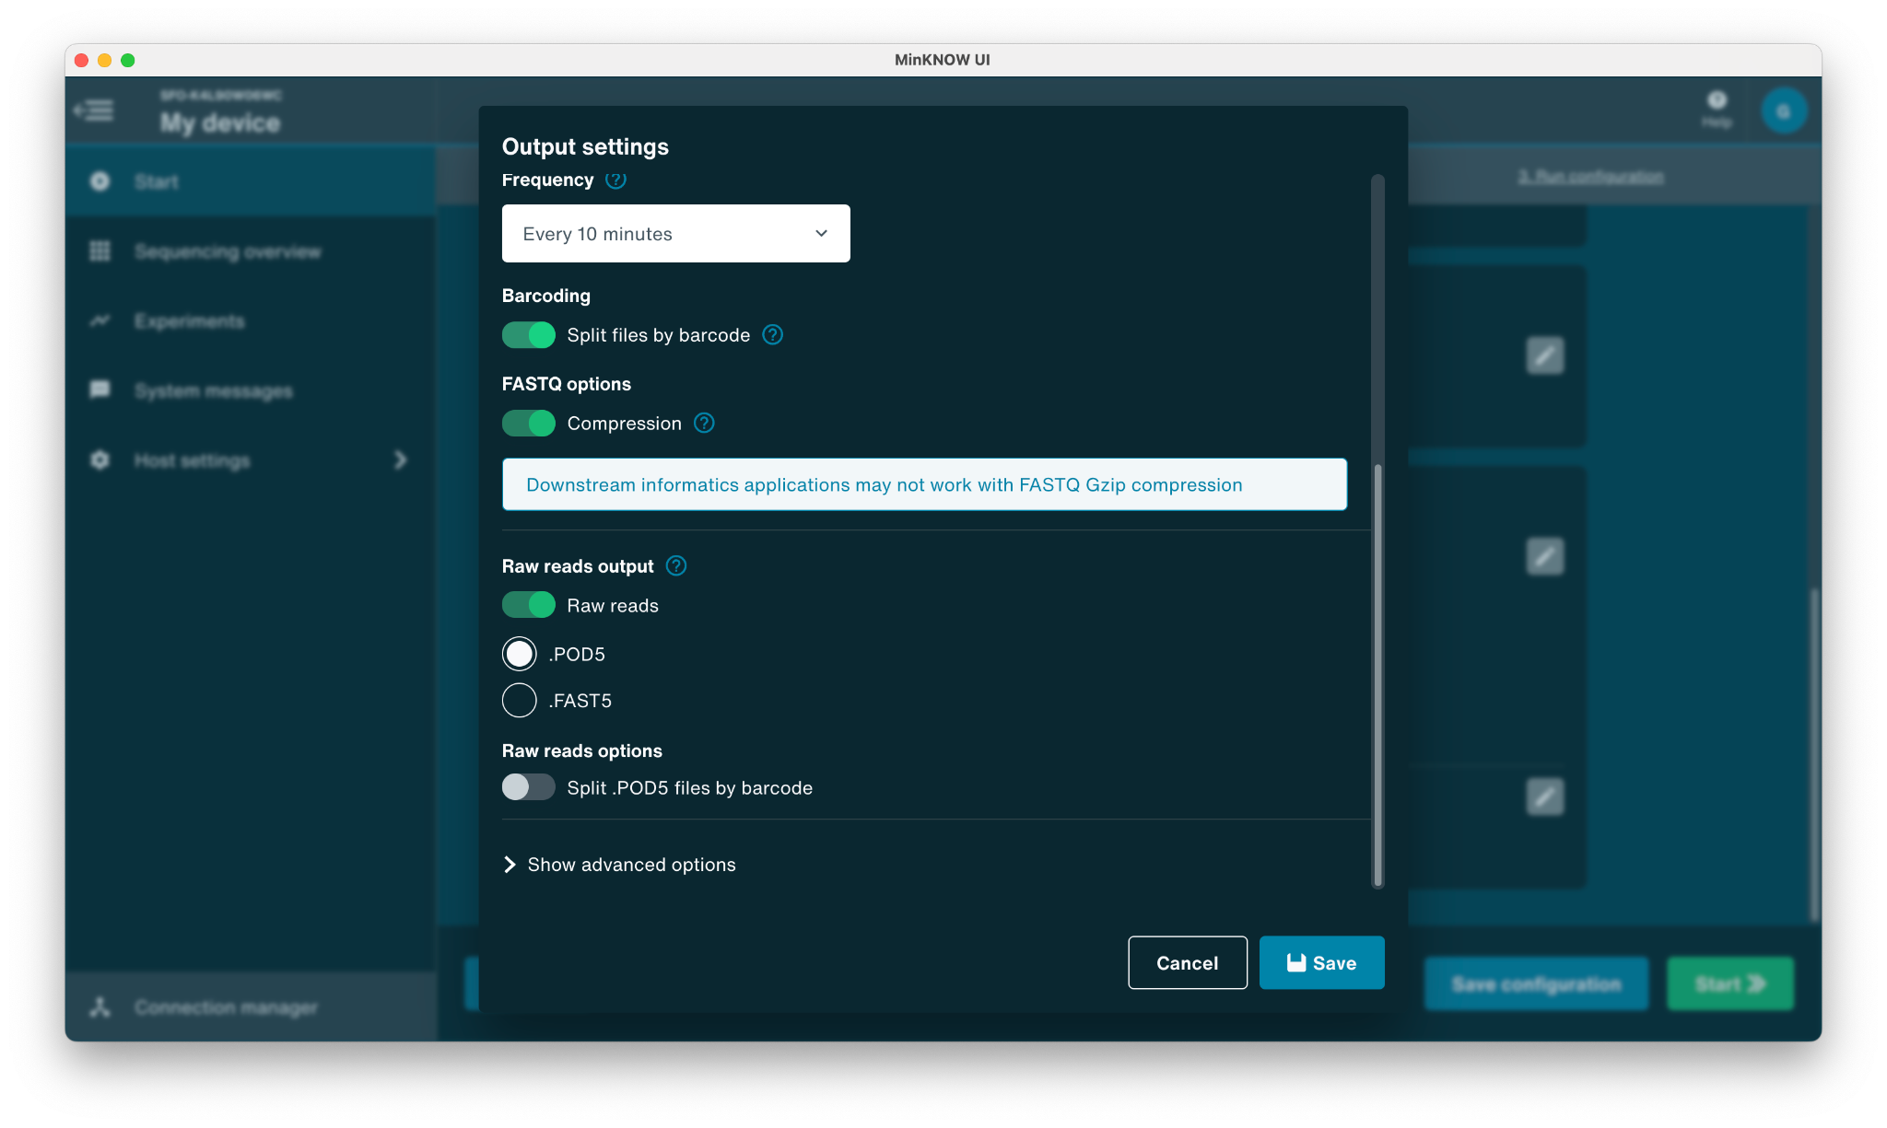
Choose output files to store
It is recommended to save raw .POD5 files
(in case you want to repeat basecalling in the future)
Save and continue to start the run

Slide 20
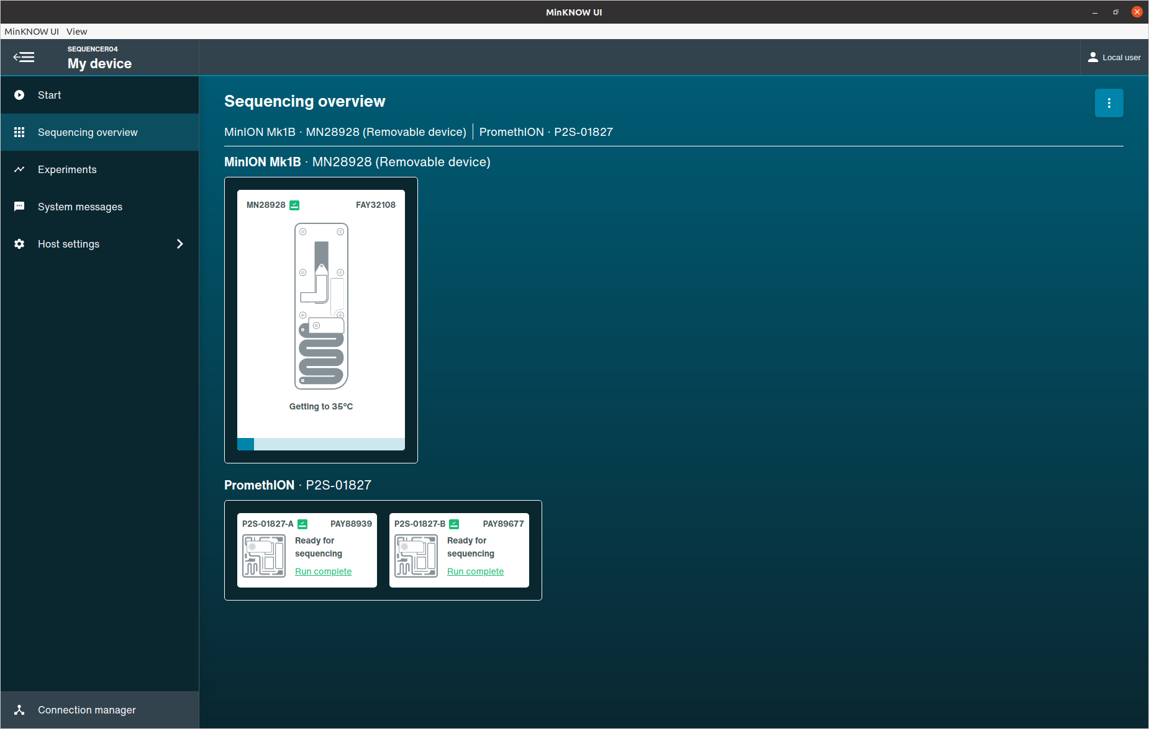
Start the run
Flow cell warms up to 37˚C and another flow cell check is performed
Then run will begin

Slide 21
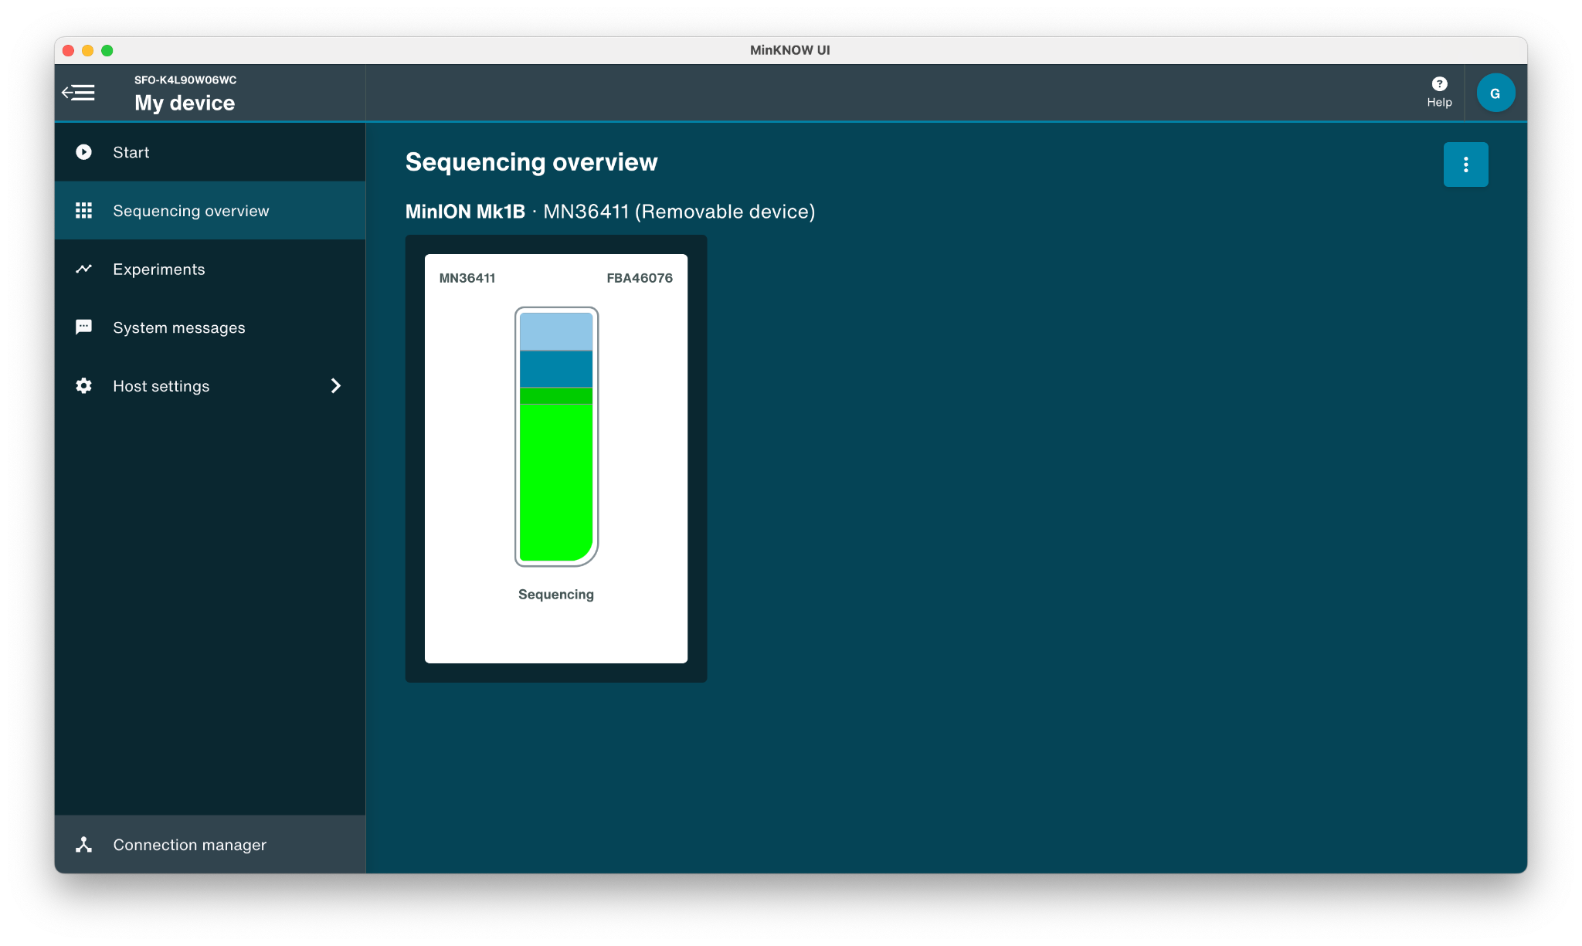
Monitor the run
Click on flow cell image to monitor run

Slide 22
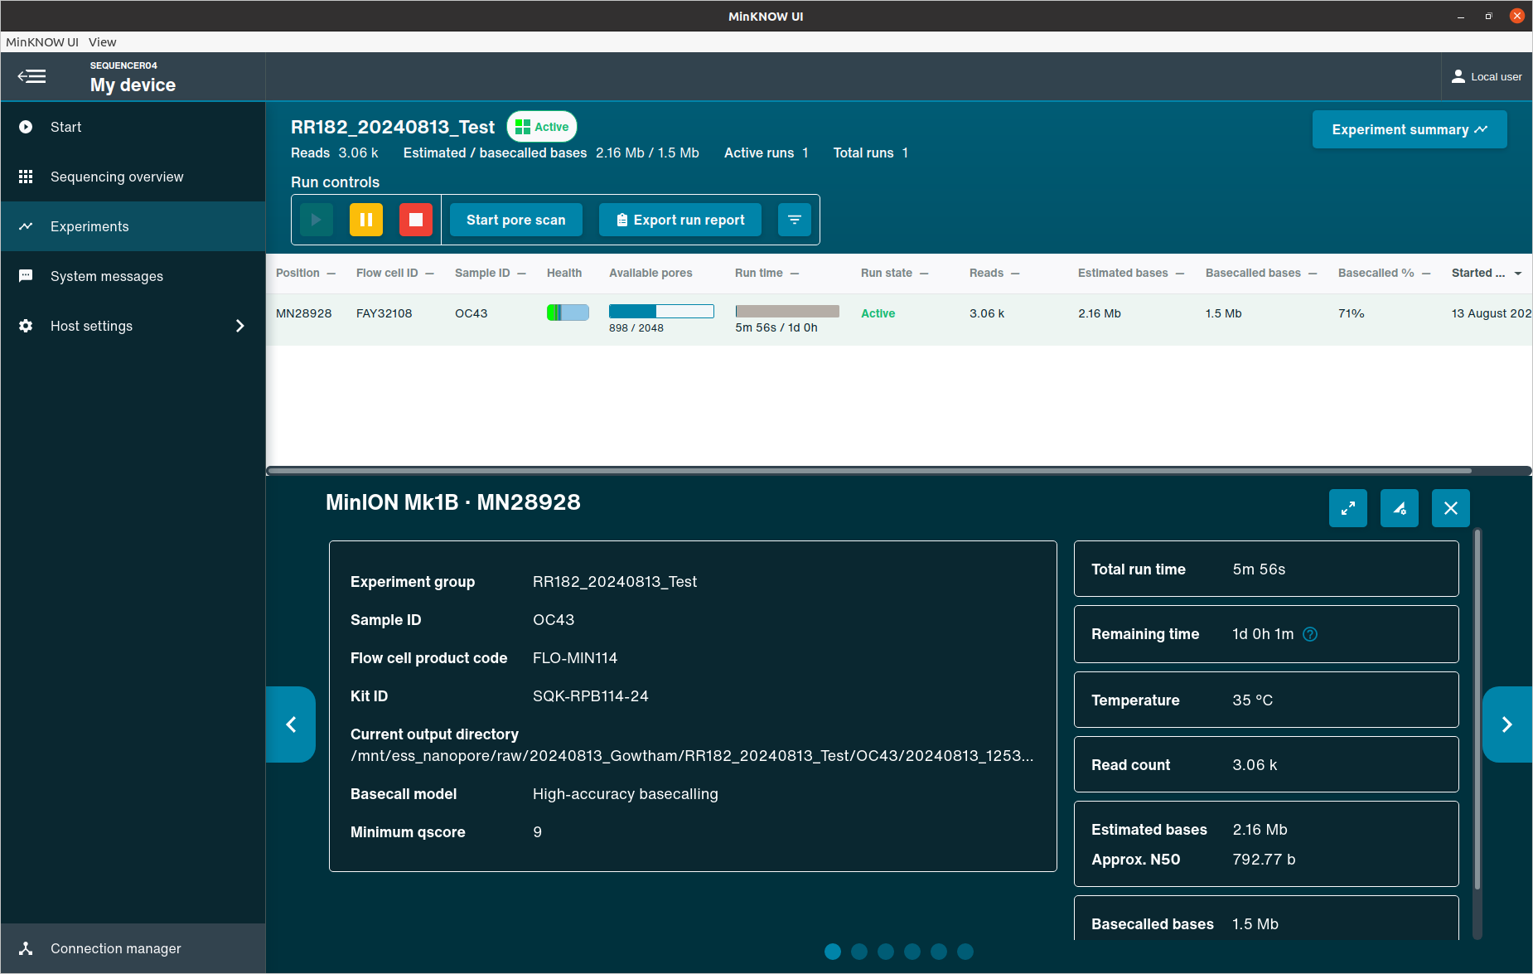
Monitor the run

Slide 23
After a run
Check the run report to see approximately how many pores are available
Wash the flow cell if it is worth saving
Run flow cell check to see how many pores are still available after wash
Start another run or add storage buffer and save at 4C

Slide 24
Computer considerations
POD5 files are very large
  Ensure there is a storage plan in place to maintain space on the computer
  You may want to move or discard POD5 files at a regular cadence
Always have 300GB available before every run
  A backup 5TB+ drive or a NAS (Network attached storage) are options to use for longer storage to keep your local storage clean

Slide 25
Next: 08-O_Sequencing Run QC for ONT Slides & Activity

